Slide 1

GROUP - 3
Day Care

Slide 2


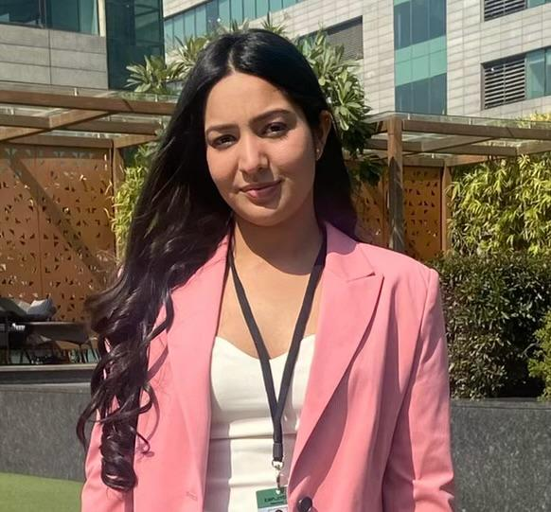

Meet the Group
Ankush Maheshwari
Madhu Sai Kalyan Kaluri
Tanmay Uday Gokhale
Mridula Prabhakar

Slide 3





Meet the Group
Amar Nagargoje
Mihir Dadwal
Khushank Mistry
Neha Balaji
Ruthvik Ravi

Slide 4

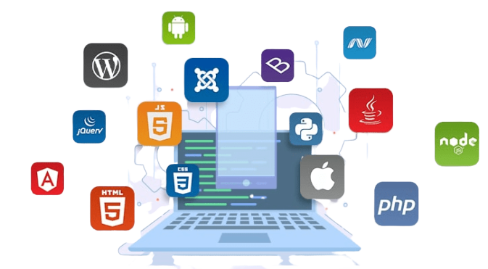
Tech Stack
Java
Swing
SQL
CSV

Slide 5


Functionalities
Efficiently capture student details: Name, age, along with essential parent/guardian information: Names, addresses, and phone numbers.
1
Implement robust system for tracking annual student registration renewals, ensuring timely and accurate updates.
2
Comply with state regulations by assigning students to teachers and organizing student/teacher groups into classrooms accordingly
4
Utilize CSV-based immunization records to effectively track and manage student immunization anniversaries
3
5
Implement an effective system to track and conduct annual employee reviews for comprehensive performance evaluation

Slide 6




Contributions
Track student immunization anniversaries Immunization records from CSV file
Enroll students: capture data
Amar Nagargoje, Tanmay Gokhale, Mridula Prabhakar
Ankush Maheshwari, Madhu Sai Kalyan Kaluri
1
3
Track annual student registration renewal
Assign students to Teachers according to state regulations
Mihir Dadwal
Tanmay Uday Gokhale, Amar Nagargoje
2
4

Slide 7
Contributions
Assign student/teacher Groups to classrooms according to state regulations
Ruthvik Ravi, Neha Balaji
5
Track annual employee review
Khushank Mistry
6

Slide 8

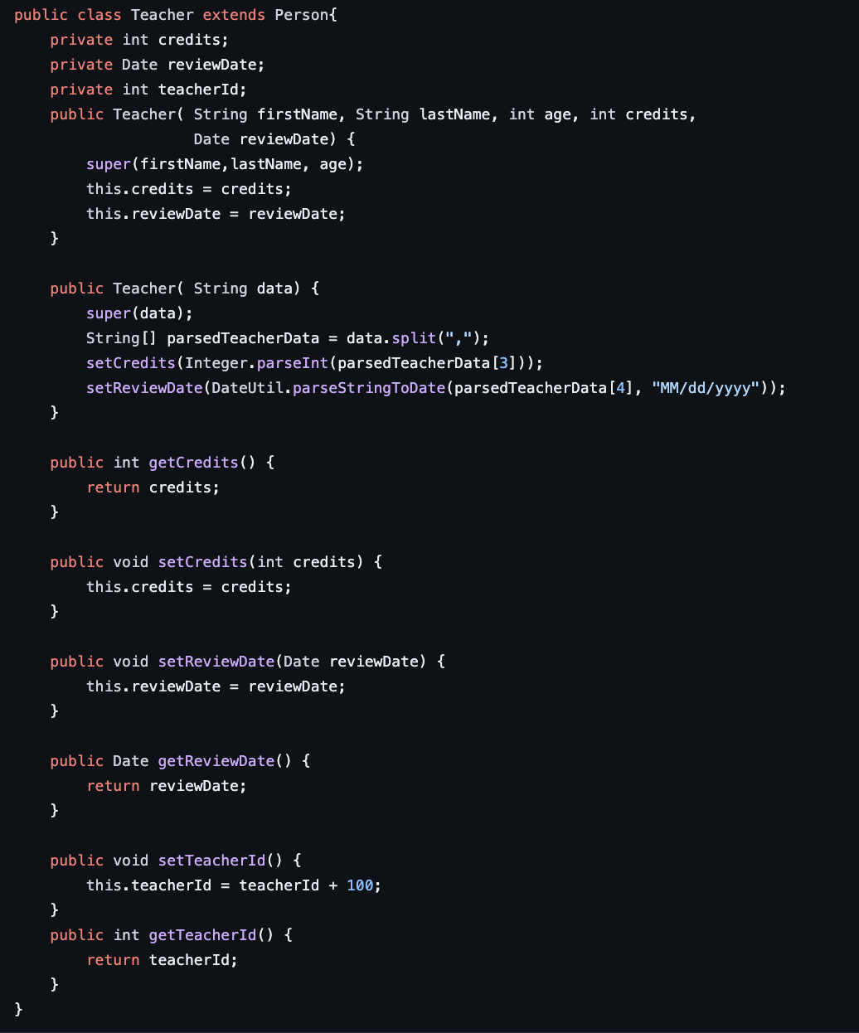
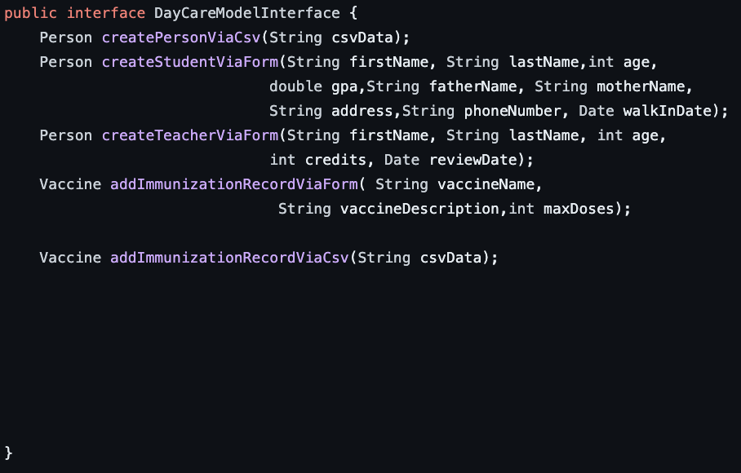
OOPS Concepts
Inheritance | Abstraction

Slide 9
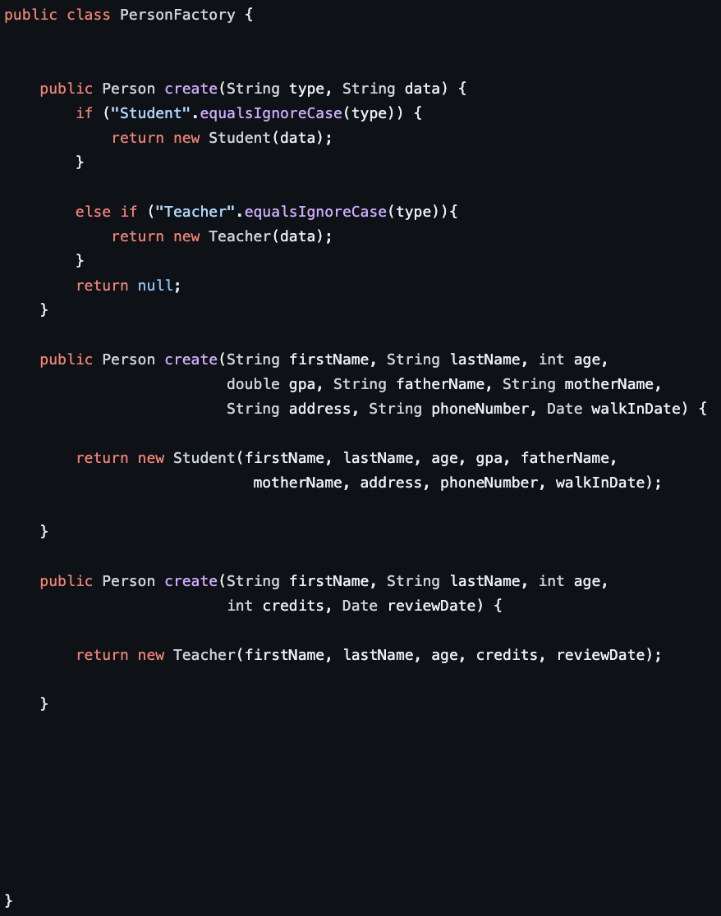
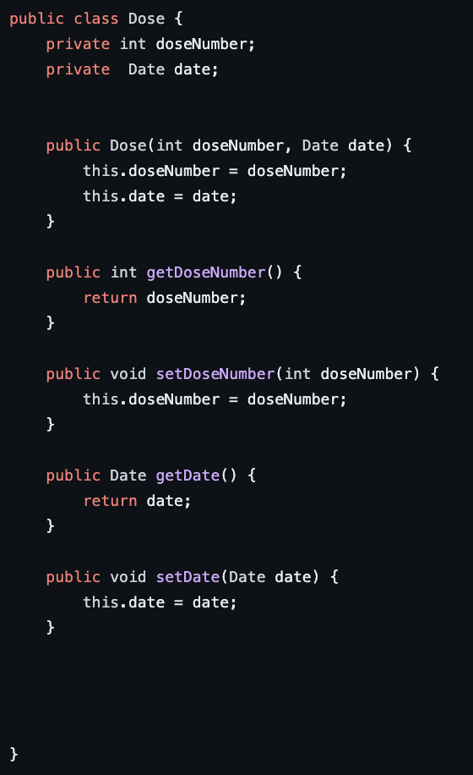
OOPS Concepts
Encapsulation | Polymorphism

Slide 10
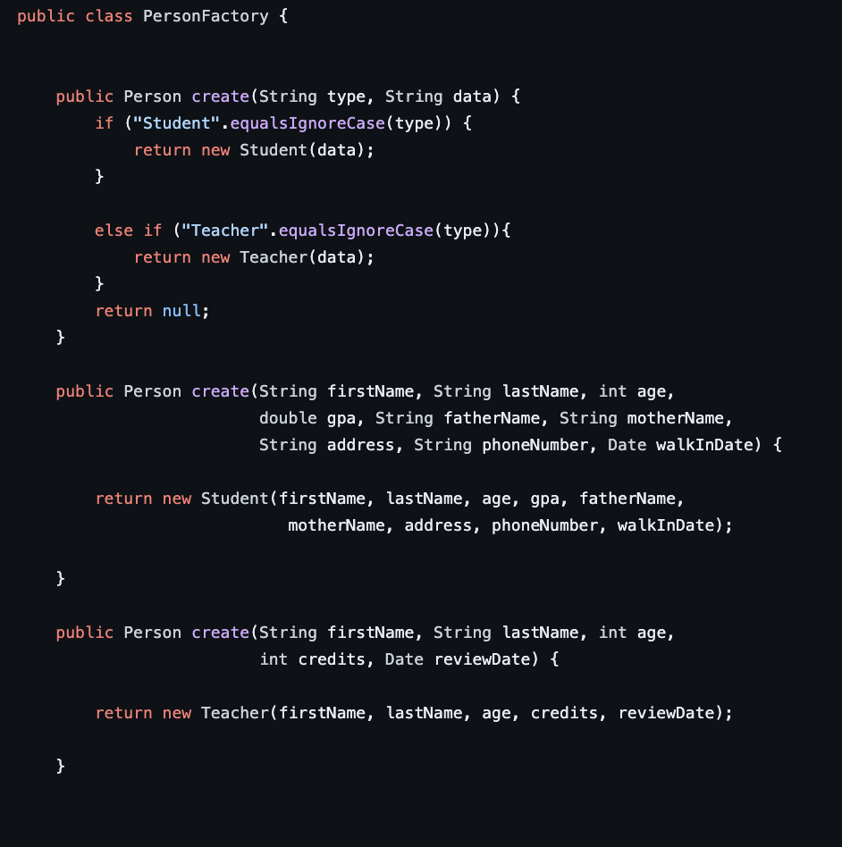
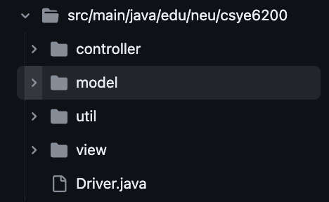
Design Patterns
Factory | MVC

Slide 11
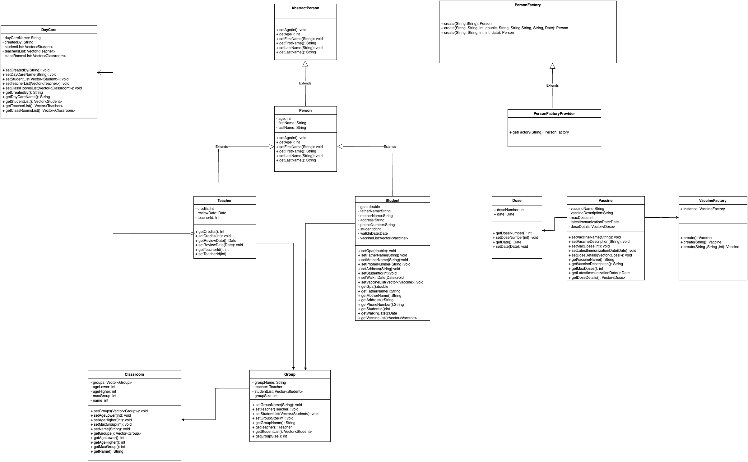
UML Diagram

Slide 12
Future enhancements
Add Doctor details for each student
Add Dietary restrictions and Food type for each student
Add Progress report for each student
Add class schedule for all the classes
Add alerts/ notification system

Slide 13
Lessons learned
Implementation and benefits of OOPS concepts in a project
Leveraging various design patterns for different use cases in a project
Swing GUI to build basic Interfaces
File I/O operations to persist and utilize data
Separation of data, business logic and UI using Model view controller design pattern

Slide 14

Thank You

